Slide 1

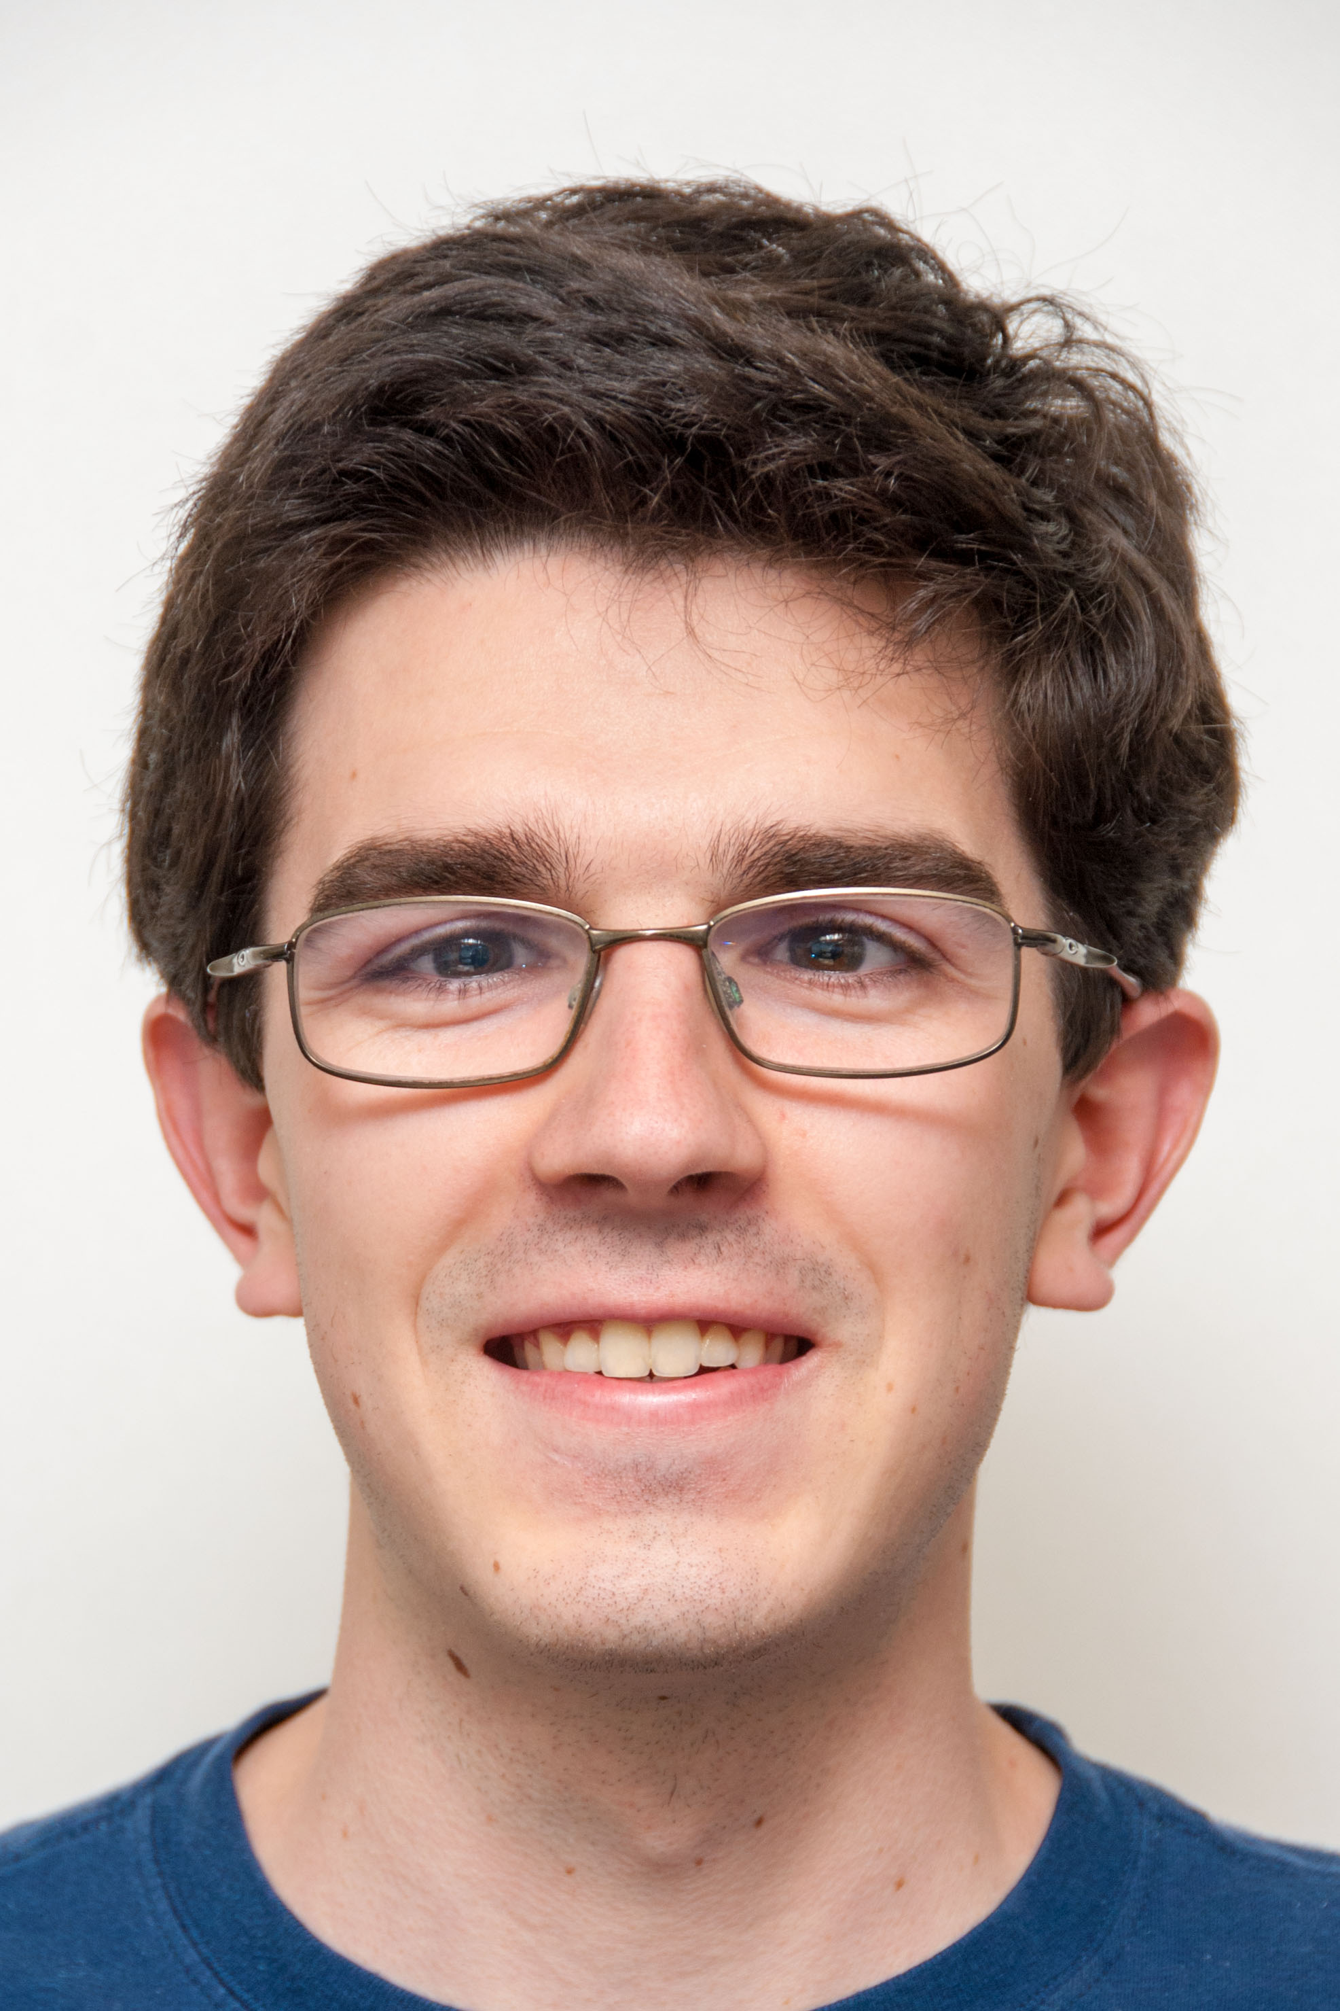
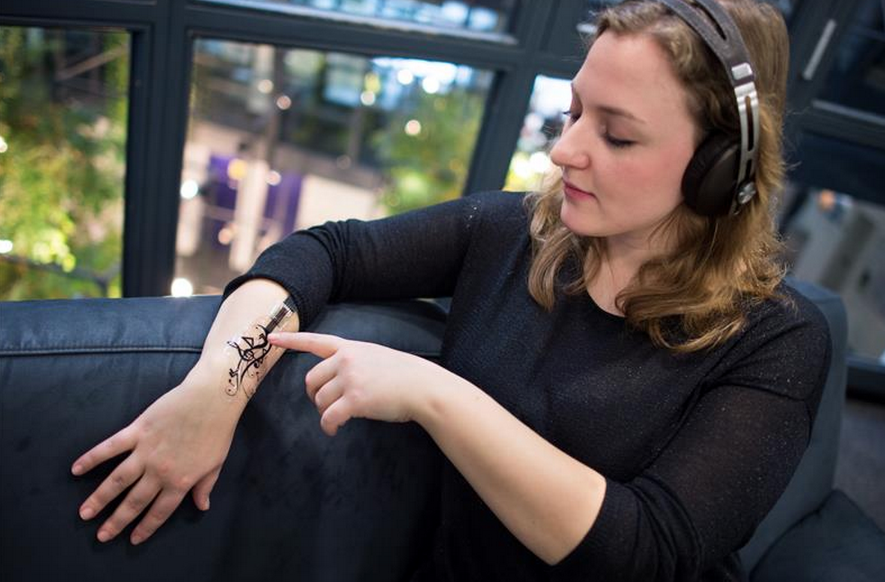
Flexible Sensors turn skin into input!
The Beauty and Joy of Computing Lecture #9 Global Impact of Computing I
Michael Ball
Researchers at CMU and Saarland University have developed “iSkin” touch-sensitive flexible sensors attached to simple medical adhesive (like a band-aid) that allows you to control your mobile device discreetly!
embodied.mpi-inf.mpg.de/research/iskin/

Slide 2
Global Impact of Computing

Slide 3
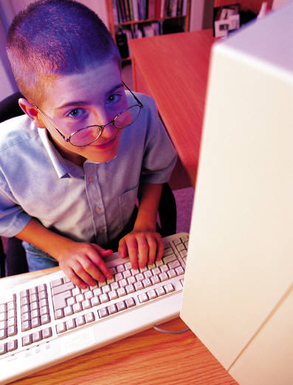
Global Impact of Computing
This course is NOT just about programming!
Videos
Big ideas
Coding Demos
Reading
Big Ideas
Labs
Programming
Activities
Everything

Slide 4

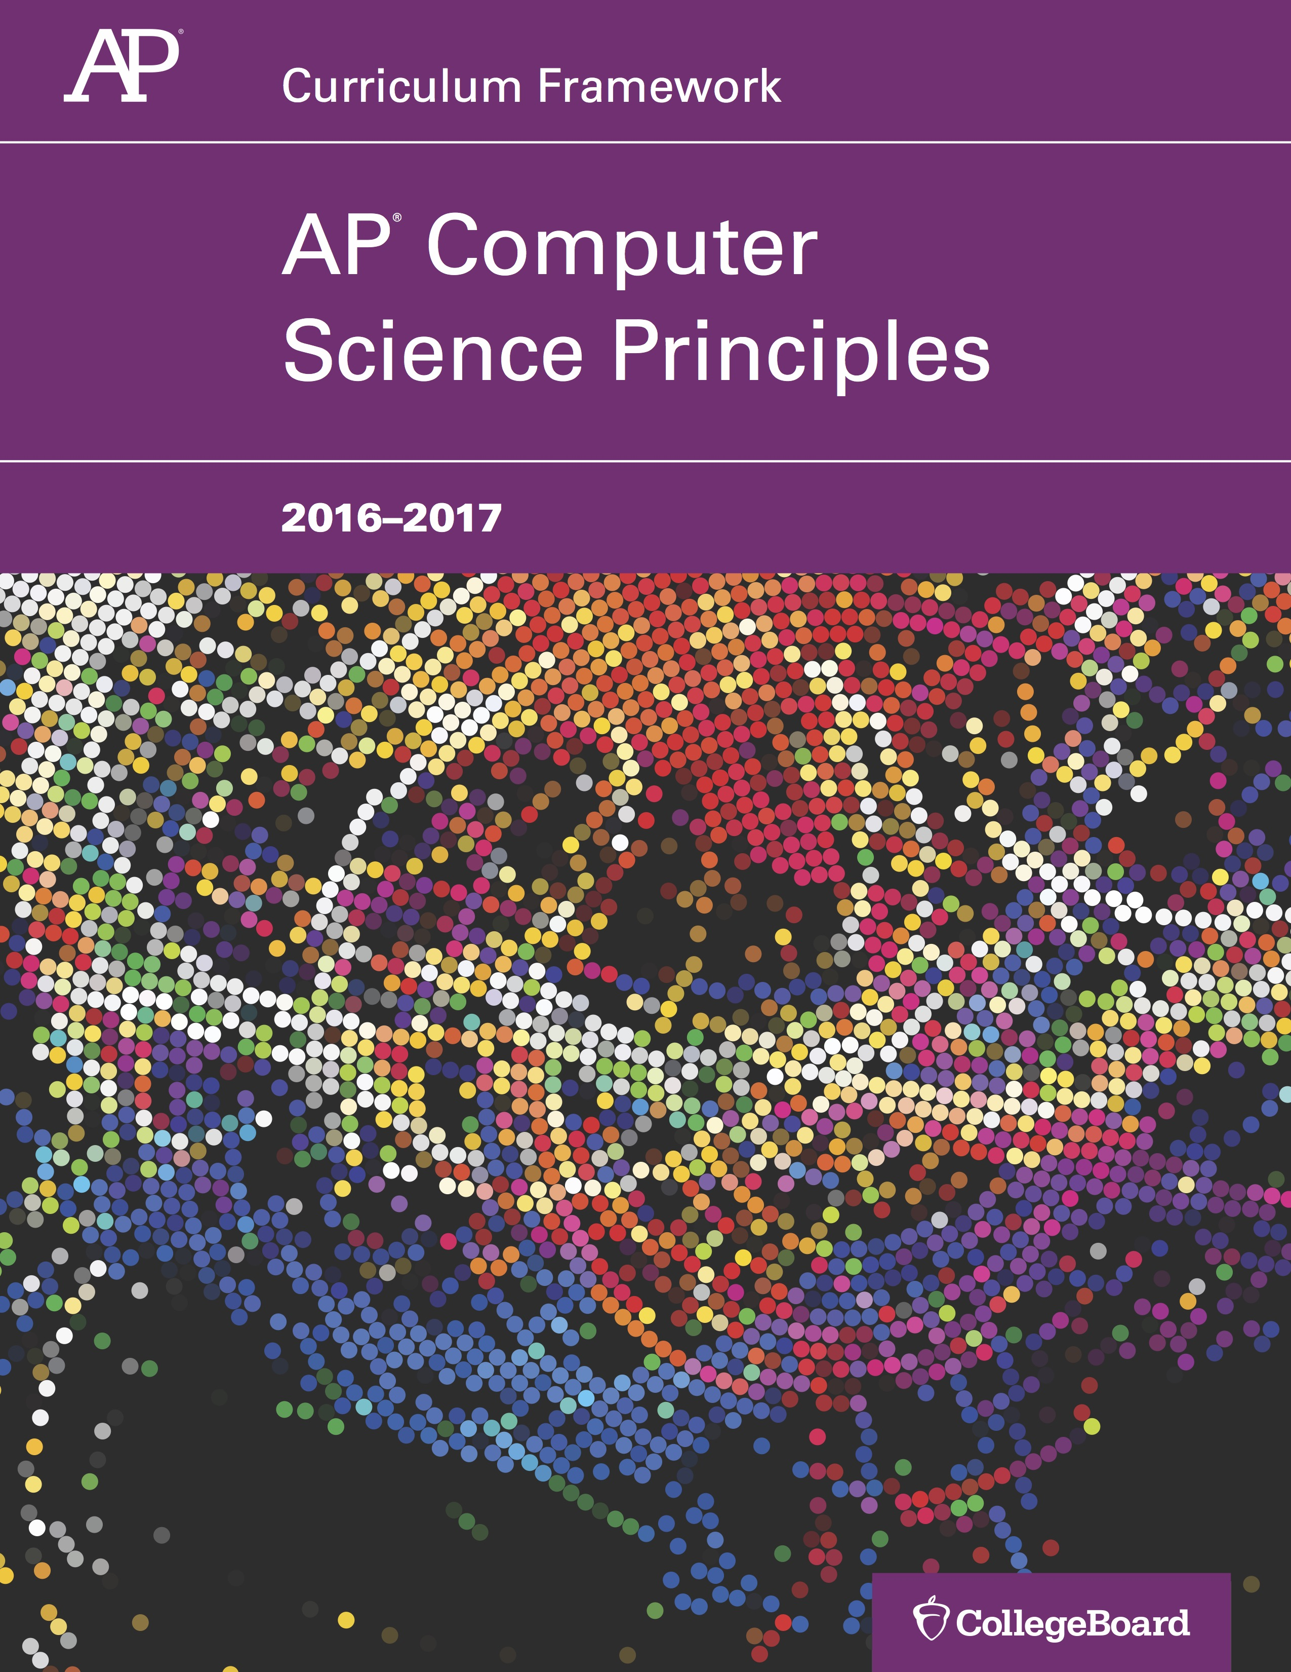
(AP) Computer Science Principles
7 Big Ideas
Creativity
Abstraction
Data and Information
Algorithms
Programming
The Internet
Global Impact

Slide 5
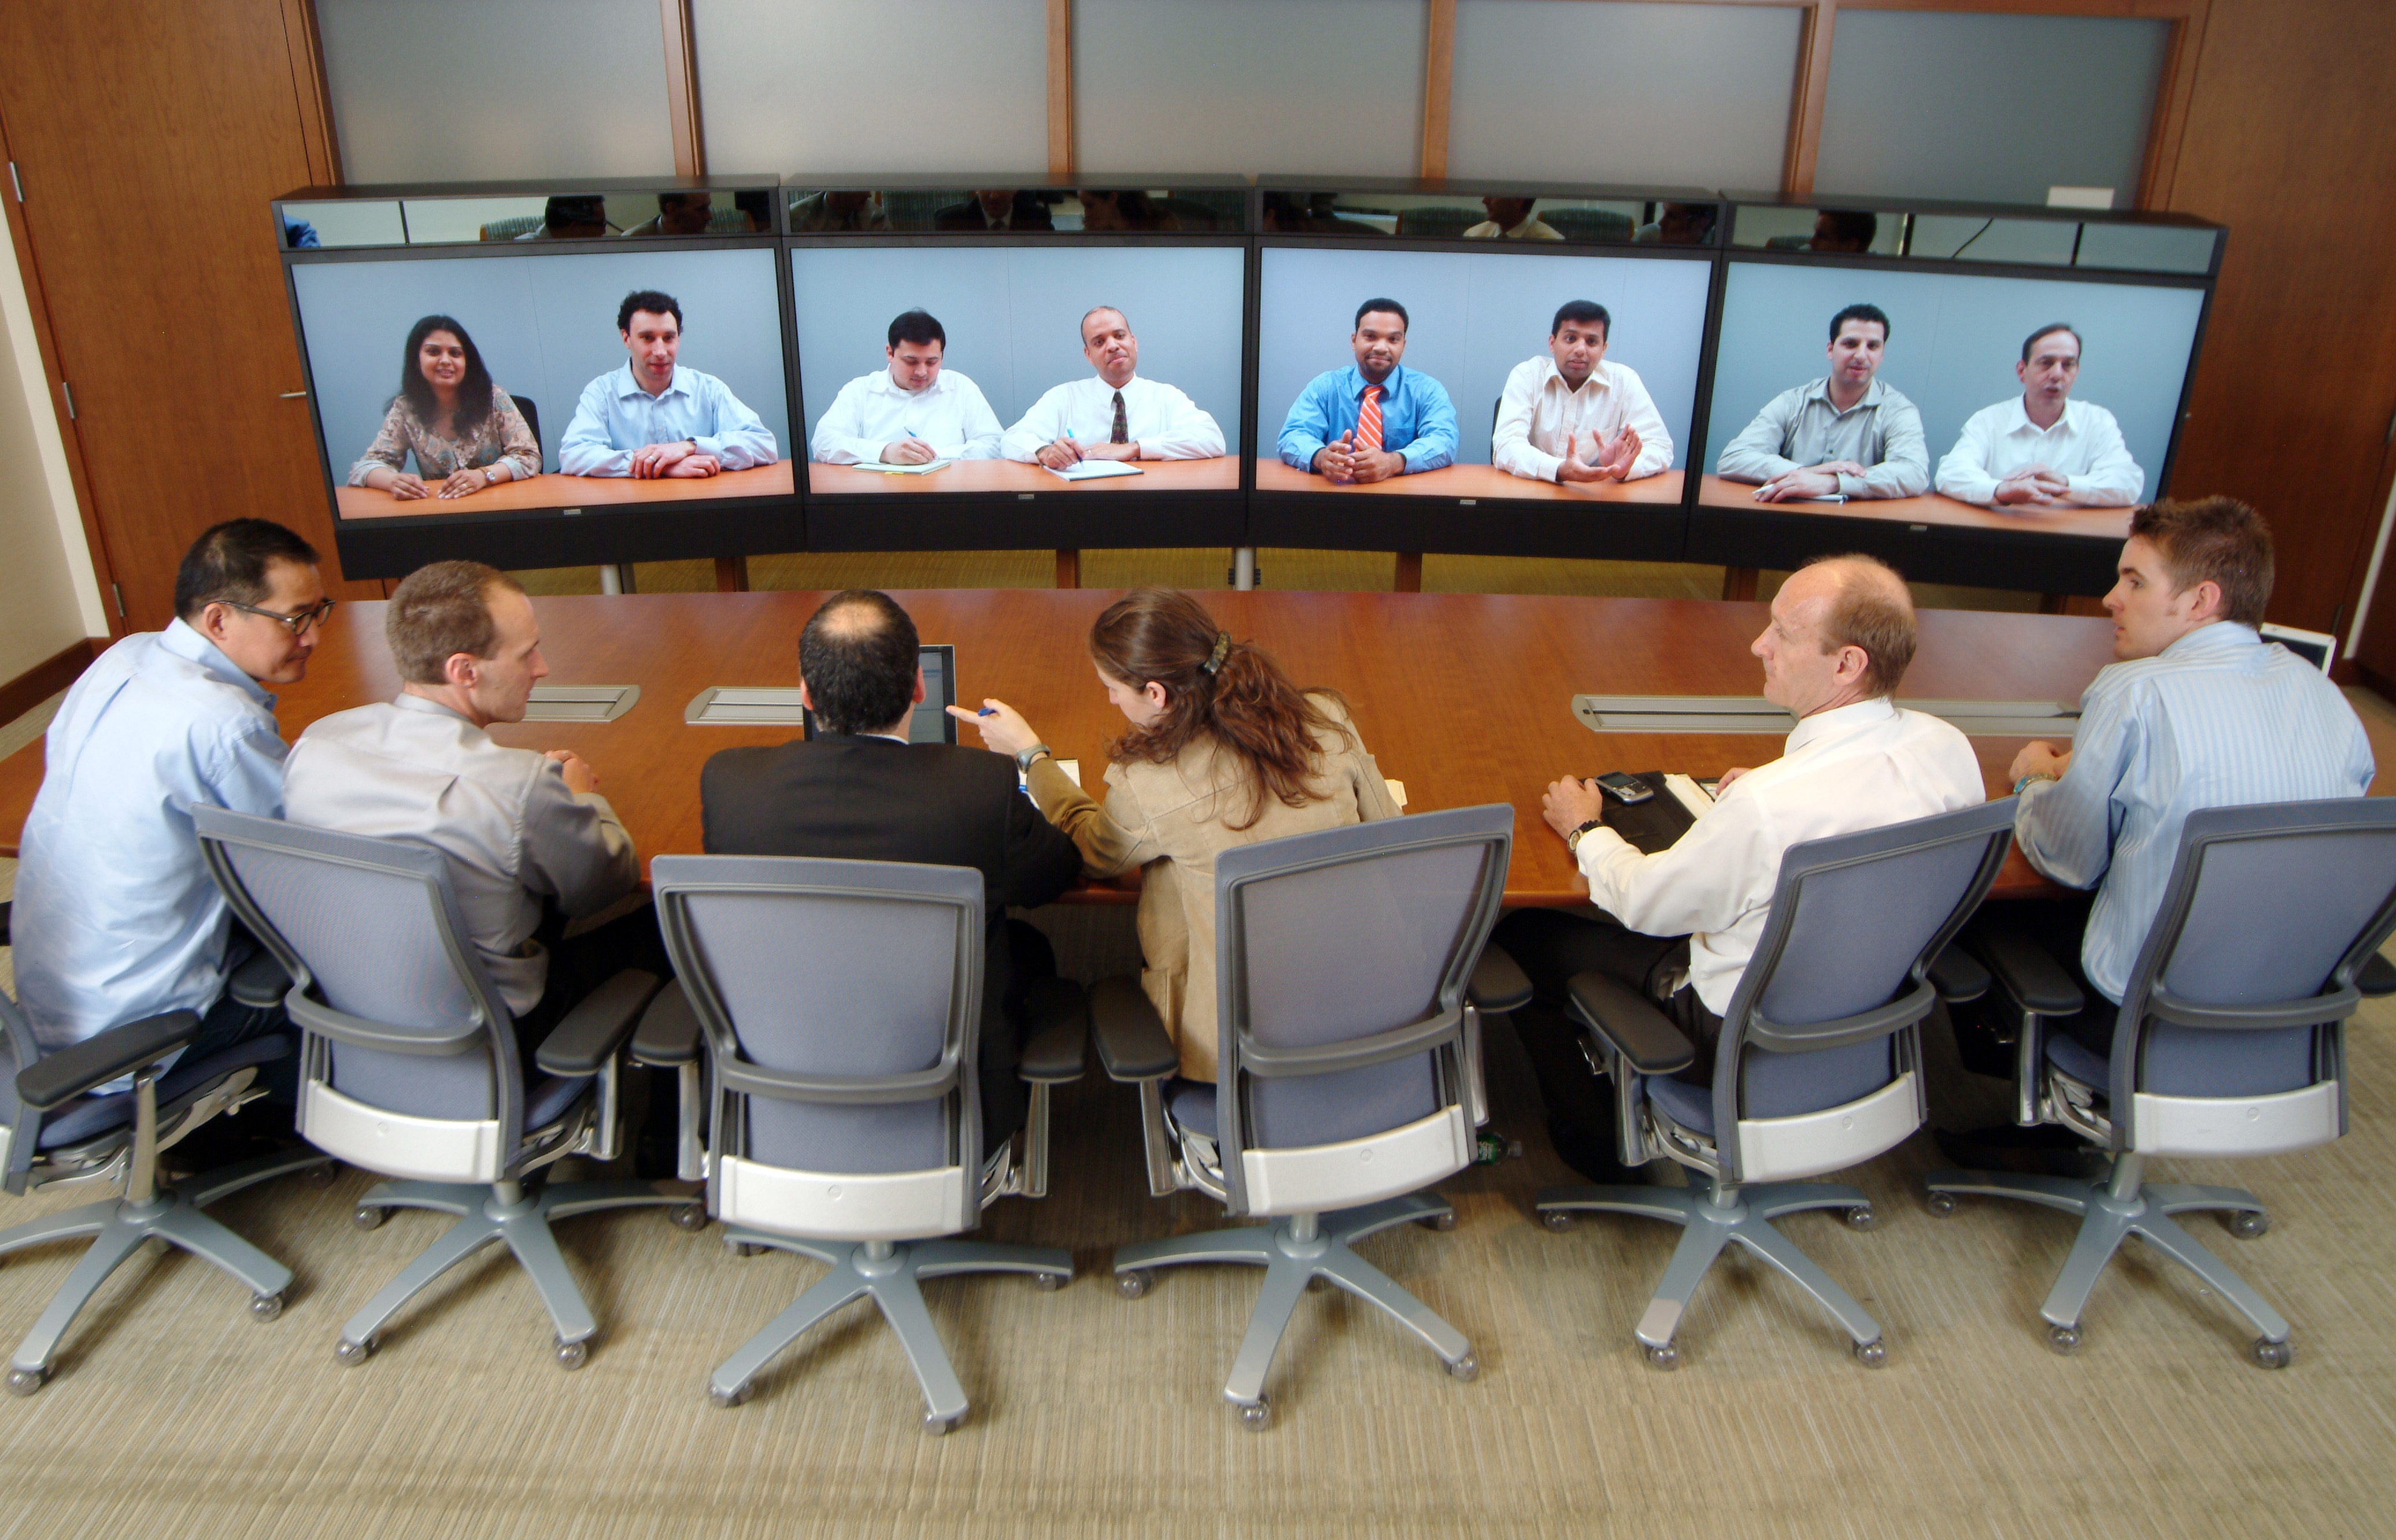

Communication, Interaction & Cognition I
New ways to communicate and collaborate!
Internet and Web
Email, SMS, Chat
Video conferencing, video chat
Cloud computing
Social media, and it’s evolving
Widespread access to information facilitates identification of problems, development of solutions (esp w/public data), and dissemination of results
Social media (e.g., blogs, Twitter) helps w/dissemination
Telepresence System by Fuelrefuel (Wikipedia)
Netflix Prize

Slide 6
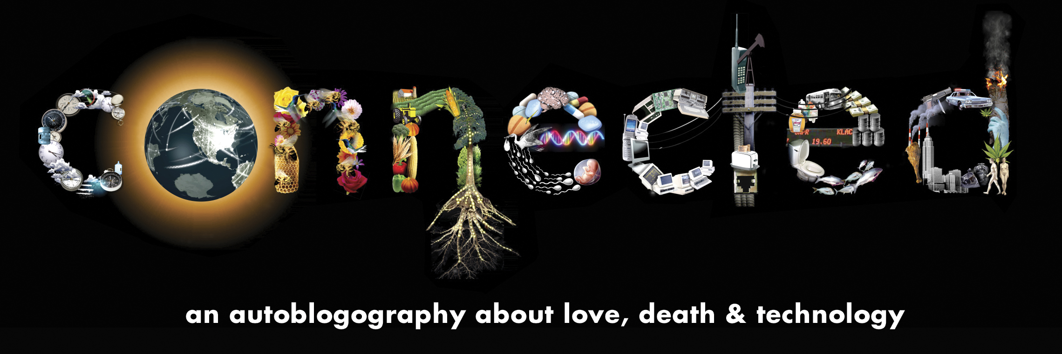
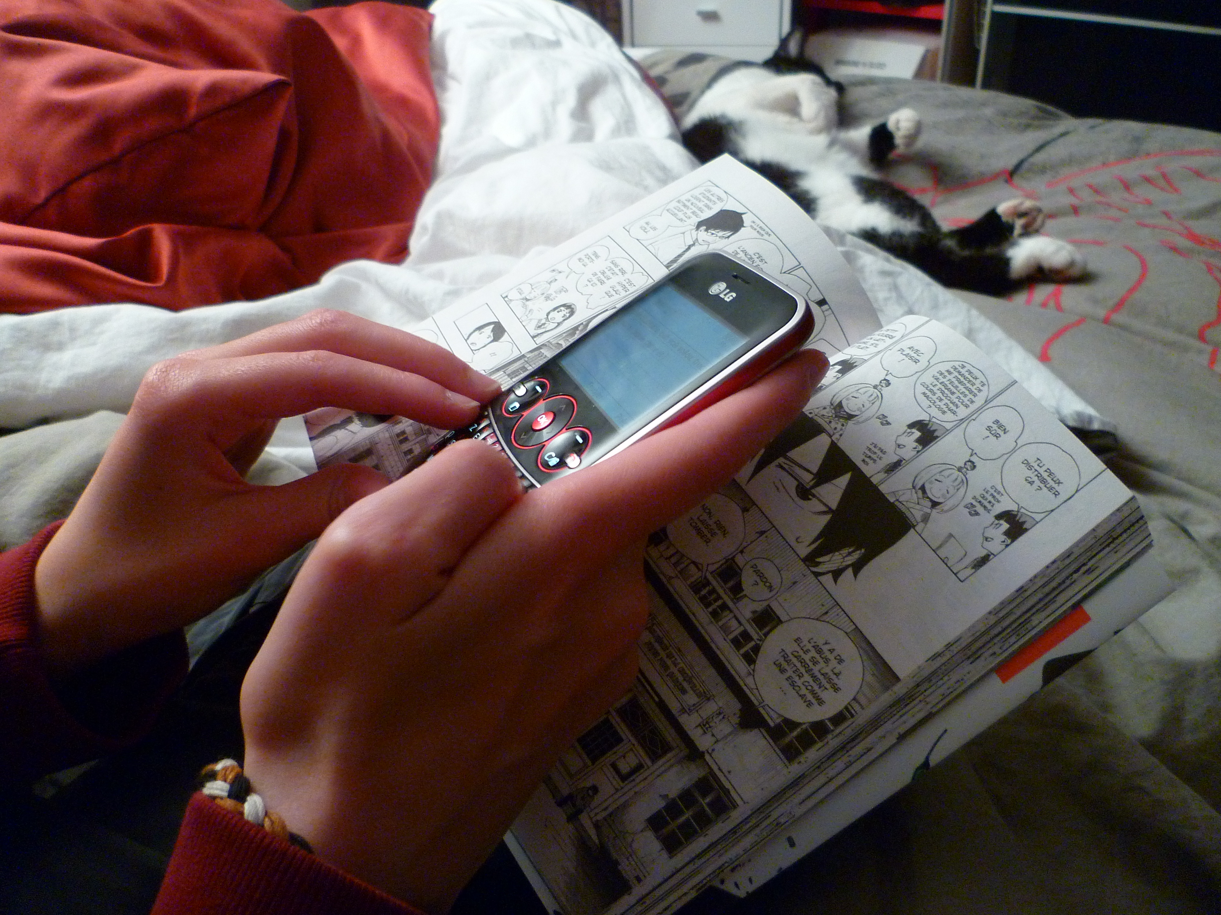
Communication, Interaction & Cognition II
Human capabilities are enhanced by digitally enabled collaboration
The Internet & the Web have
changed many areas, including e-commerce, health care, access to information and entertainment, and online learning
impacted productivity, positively and negatively, in many areas
Connected (the film) by Tiffany Shlain)
Teenage Girl Texting by Olybrius (Wikipedia)

Slide 7
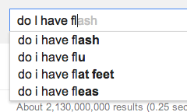
Search Trends Are Predictors!
en.wikipedia.org/wiki/Google_Trends
google.com/trends

Slide 8
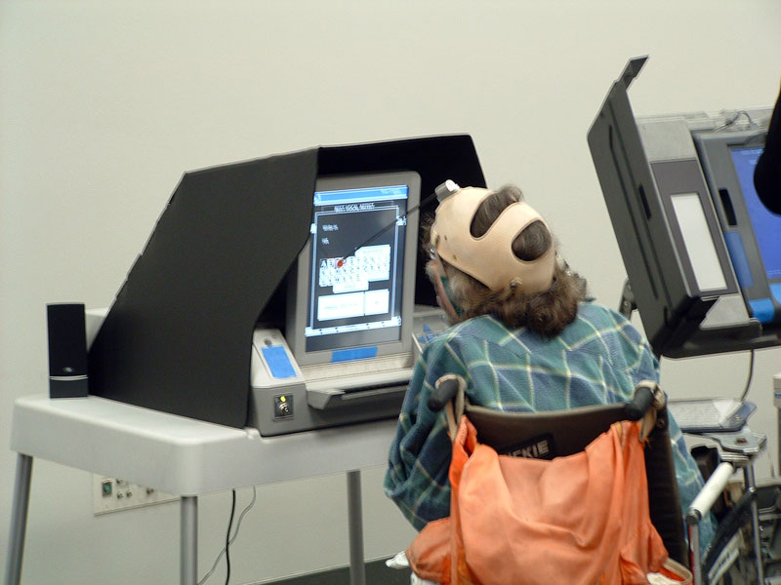
Hardware Support
The desktop-to-(always-on)-mobile computers shift is leading to new applications
Global Positioning System (GPS) and related technologies have changed how humans travel, navigate, and find information related to geolocation
Sensor networks facilitate new ways of interacting with the environment and with physical systems
Smart grids, smart buildings, and smart transportation are changing and facilitating human capabilities
Computing contributes to many assistive technologies that enhance human capabilities
Sensor Network
Voting on a touchscreen by Joebeone Iwikipedia)

Slide 9
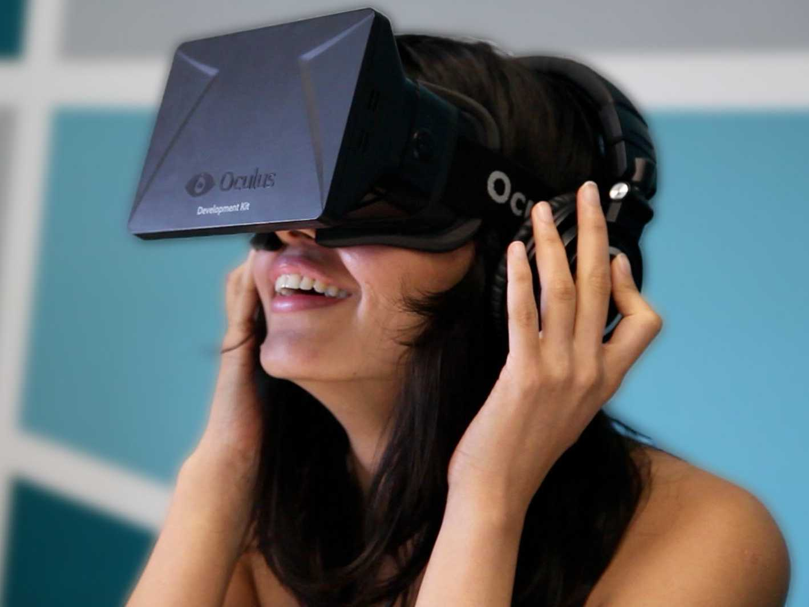
Most significant assistive technology
Augmented reality
Virtual reality
Hearing aids
Self-driving cars
Wheelchairs

Slide 10
Citizen Participation

Slide 11
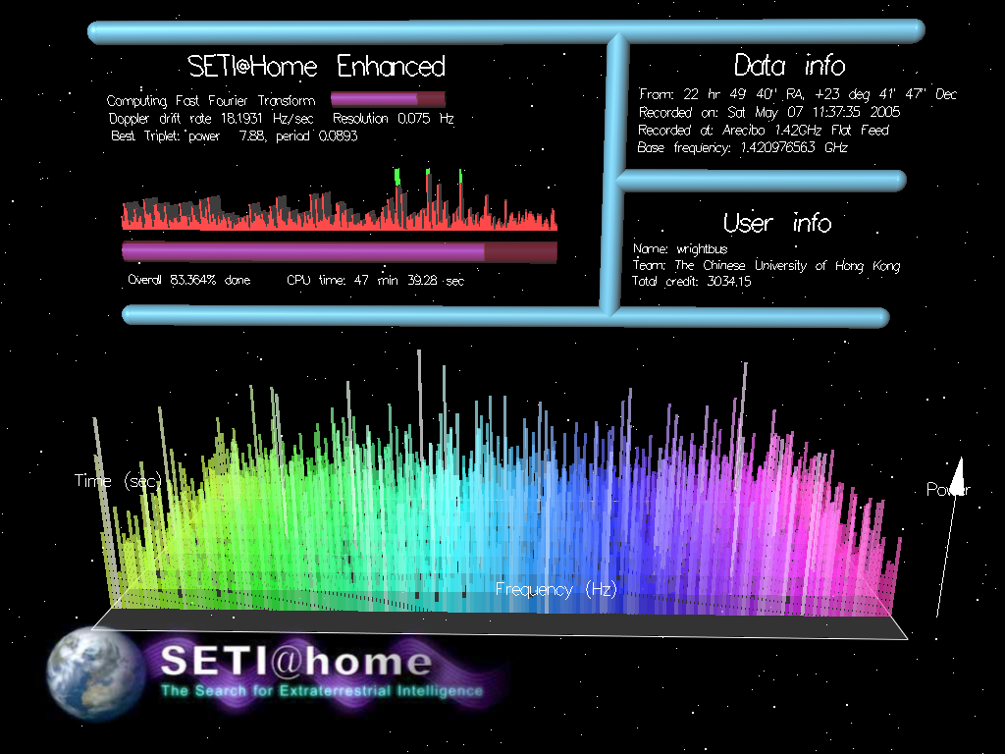
Citizen Participation I
youtu.be/_aIJV5aQR68
setiathome.ssl.berkeley.edu
People participate in a problem-solving process that scales
Distributed solutions must scale to solve some problems.
Science has been impacted by using scale and “citizen science” to solve scientific problems using home computers in scientific research.
SETI @ Home by Wrightbus (Wikipedia)

Slide 12
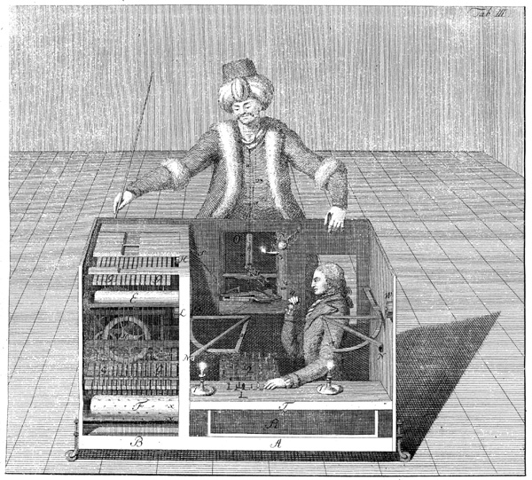
The Turk (1770)
en.wikipedia.org/wiki/The_Turk
A Hoax!
Built by Wolfgang von Kempelen
to impress the Empress
Could play a strong game of Chess
Thanks to Master inside
Toured Europe
Defeated Benjamin Franklin & Napoleon!
Burned in an 1854 fire
Chessboard saved…
The Mechanical Turk (1770)

Slide 13

Citizen Participation II
en.wikipedia.org/wiki/Amazon_Mechanical_Turk
www.thesheepmarket.com
thesinglelanesuperhighway.com
Human computation harnesses contributions from many humans to solve problems related to digital data + Web
E.g., Missing Person Searches, Transcription / Translation, Social Science Experiments, Art research
Some online services use the contributions of many people to benefit individuals and society
Crowdsourcing offers new models for collaboration, such as connecting people with jobs and businesses with funding
Amazon Web Services Icon by Amazon (Wikipedia)

Slide 14

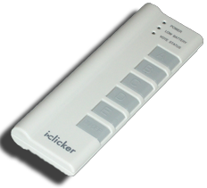
Hourly rate for drawing sheep?
$0.02/hr
$0.19/hr
$0.58/hr
$1.97/hr
$5.00/hr
(source: thesheepmarket.com)

Slide 15
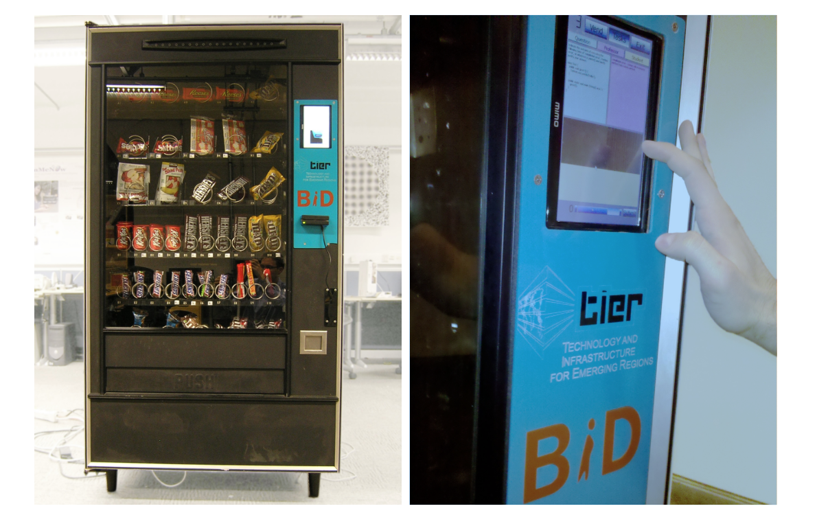
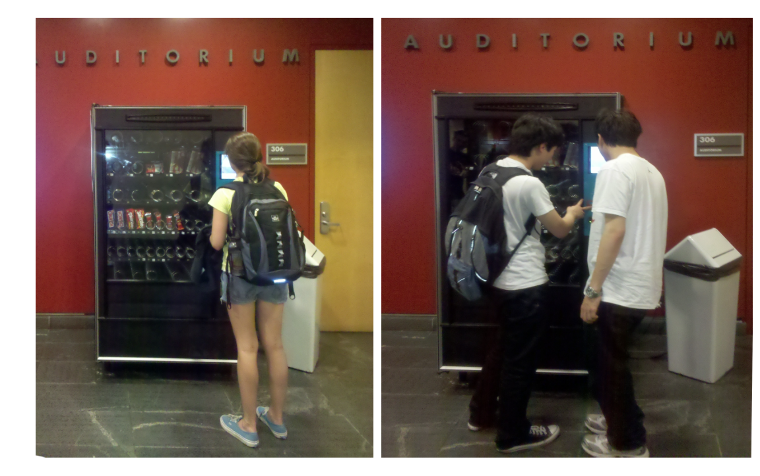
Grading Papers → Candy?
https://bid.berkeley.edu/files/papers/heimerl-umati-chi2012.pdf

Slide 16
Computers and Education

Slide 17
Question (thanks to BH)
The most important use of computers in education so far...
Web search
Arithmetic drill programs
Word processing
iclicker-like technologies
Social networking
Notes:
Answer: D (includes everything in which the computer poses a question and you have to answer in a computer-readable form, which so far means multiple choice)

Slide 18

Answer
“Multiple choice tests have changed what counts as knowledge in schools. Open-ended questions were the norm 30 years ago. The kind of knowledge you can report on multiple-choice tests is unimportant in the big scheme of things, and what’s really important is not what you already know, but how you can take what you already know and apply it something you’ve never seen before. Multiple choice tests make that hard. Teaching follows tests! The folks who invented Standardized Testing didn’t foresee how it would affect what knowledge means! (unintended consequence)” – Brian Harvey

Slide 19
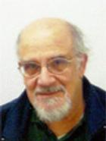
Computers in Education
www.youtube.com/watch?v=NZNTgglPbUA
Judah Schwartz
Tools
Word Processor
Browser
Microworlds
Interactive geometry
Physics simulation
Courseware
Arithmetic drill
Computer-assisted instruction
Programming language
Databases(e.g., atlas)
Computer-managed instruction
ASSIST movie

Slide 20
Then what about MOOCs?
MOOC: Massive Open Online Course
Pro:
Way better than nothing for people stuck in Podunk.
Learn from the best lecturers.
Encourage learning for its own sake (vs. credentialling).
Con:
Overemphasis on lectures (and maybe homework) over discussion and a community of learners.
Encourage universities to think of courses as cash cows.
Not so good at credentialling.
Notes:
Sorry if you live in a place named Podunk...
MOOC = Massive Open Online Course. A topic of heated debate at universities, hence this slide.

Slide 21
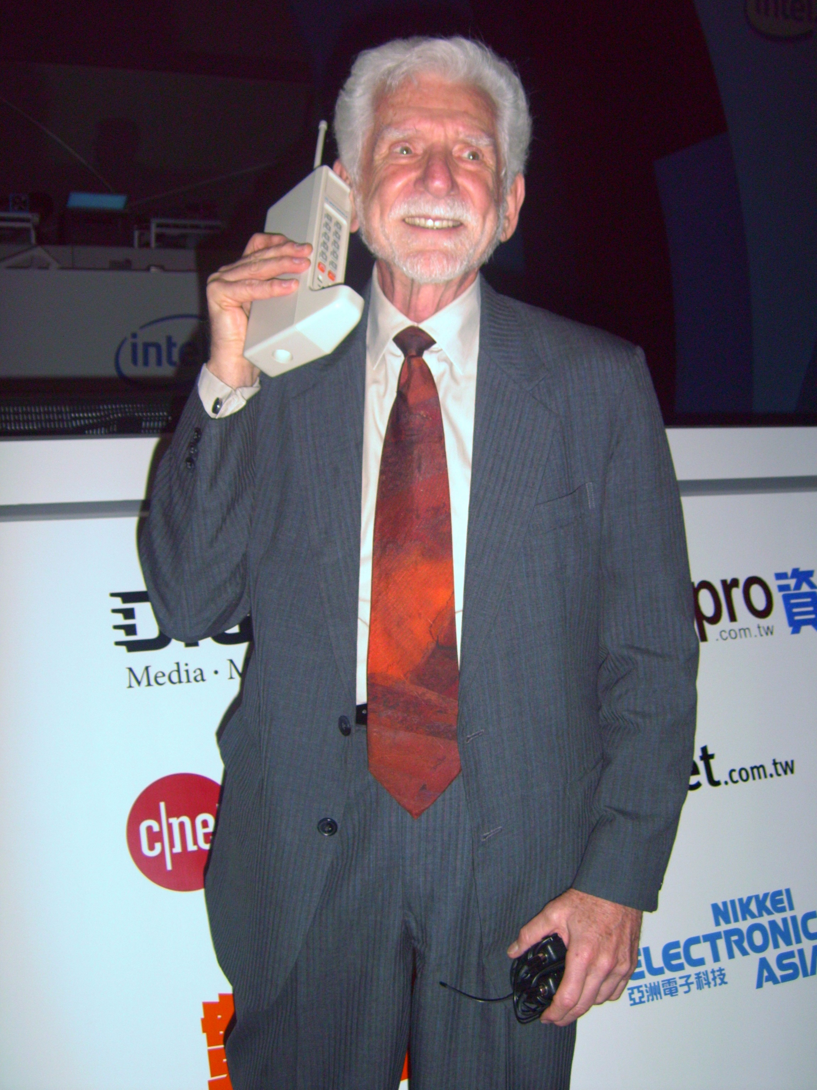
Summary
Computing has global impact.
Computation has changed the way people think, work, live, and play.
Our methods for communicating, collaborating, problem solving, and doing business have changed and are changing due to innovations enabled by computing
First Cell Call Re-enactment by BrockF5 (Wikipedia)

